Slide 1
CYBERBULLYING PREDICTION USING MACHINE LEARNING

Slide 2
Abstract
Cyberbullying is a growing concern in the digital age, affecting individuals across social media platforms. This project proposes a machine learning-based system to predict cyberbullying using sklearn algorithms. The solution utilizes NLP techniques like tokenization, stop word removal, and vectorization for text preprocessing. Models such as Logistic Regression, SVM, and Random Forest are evaluated for accuracy and efficiency. The outcome is a scalable, real-time detection system aimed at creating safer online environments.

Slide 3
Introduction
Cyberbullying has emerged as a significant issue in the digital era, with individuals facing harassment and abuse on social media platforms. Unlike traditional bullying, cyberbullying operates anonymously, occurs 24/7, and can reach a vast audience, amplifying its negative impact. This growing concern has highlighted the need for automated systems capable of detecting and mitigating such harmful behaviors in real-time.
This project focuses on leveraging machine learning algorithms to identify instances of cyberbullying based on textual data. By employing natural language processing (NLP) techniques for preprocessing and classification algorithms such as Logistic Regression, SVM, and Random Forest, the system aims to accurately classify user-generated content. The solution addresses challenges like context understanding, data imbalance, and real-time performance.

Slide 4
Existing System
Cyberbullying has emerged as a significant issue in the digital era, with individuals facing harassment and abuse on social media platforms. Unlike traditional bullying, cyberbullying operates anonymously, occurs 24/7, and can reach a vast audience, amplifying its negative impact. This growing concern has highlighted the need for automated systems capable of detecting and mitigating such harmful behaviors in real-time.
This project focuses on leveraging machine learning algorithms to identify instances of cyberbullying based on textual data. By employing natural language processing (NLP) techniques for preprocessing and classification algorithms such as Logistic Regression, SVM, and Random Forest, the system aims to accurately classify user-generated content. The solution addresses challenges like context understanding, data imbalance, and real-time performance.

Slide 5
Proposed System
The proposed system aims to predict instances of cyberbullying using machine learning techniques, ensuring real-time and accurate detection of harmful online content. It leverages the sklearn library for implementing efficient algorithms and natural language processing (NLP) for analyzing text data.
The system is designed with the following key components:
1. Data Preprocessing:
Text data is cleaned and prepared using NLP techniques such as tokenization, stop word removal, lemmatization, and vectorization (TF-IDF).
This ensures the text is converted into a structured format suitable for machine learning.

Slide 6
2.Feature Engineering:
Linguistic features like word frequency, sentiment analysis, and n-grams are extracted to capture patterns indicative of bullying behavior.
Advanced embeddings like Word2Vec or GloVe may be utilized for deeper context understanding.
3.Machine Learning Algorithms:
Models such as Logistic Regression, SVM, and Random Forest are implemented to classify text as "bullying" or "non-bullying."
Hyperparameter tuning and cross-validation ensure the robustness and accuracy of the models.

Slide 7
4.Evaluation Metrics:
Model performance is assessed using metrics like accuracy, precision, recall, and F1-score.
Special emphasis is placed on minimizing false negatives to ensure harmful content is identified effectively.
5.Scalability and Real-Time Integration:
The system is designed to handle large volumes of data, enabling real-time detection.
It can be integrated into social media platforms or moderation tools to flag harmful content instantly.

Slide 8
LITERATURE REVIEW
The rise of social media has led to increased cyberbullying, prompting research into automated detection using machine learning and NLP techniques. Early methods relied on keyword detection but lacked context understanding, resulting in inaccuracies. Recent advancements include supervised models like SVM and deep learning techniques such as CNNs, improving detection capabilities. However, challenges remain, including imbalanced datasets, nuanced language, and the need for real-time systems. This project addresses these gaps by developing a scalable and efficient ML-based cyberbullying detection system.

Slide 9
Module
ML kit
Machine Alogrithums
Flask
Python Libraries

Slide 10
ML Kit
scikit-learn (sklearn): Provides efficient tools for machine learning tasks like classification, regression, and clustering, used for algorithms like Logistic Regression and SVM.
NLTK (Natural Language Toolkit): Used for preprocessing text data, including tokenization, stemming, and stop word removal.
2. Machine Learning Algorithms
Support Vector Machines (SVM): Effective for text classification tasks, identifying patterns in high-dimensional data.
Random Forest: An ensemble method combining multiple decision trees for robust and accurate predictions.

Slide 11
3. Flask
RESTful API Creation: Flask is used to create endpoints that serve the cyberbullying detection model in real time.
Model Deployment: Facilitates deploying the trained model as a web service accessible to various platforms.
4. Python Libraries
Pandas: Used for data manipulation and cleaning, ensuring high-quality input for ML models.
Matplotlib: Provides visualization tools for analyzing and presenting data and model performance.

Slide 12
Software Components
Python: The primary programming language for implementing machine learning models and data processing workflows.
Jupyter Notebook: An interactive development environment used for coding, testing, and visualizing data and results.
Hardware Components
Processor: A multi-core processor, such as Intel i5 or above, for handling computational tasks efficiently.
RAM: Minimum 8GB RAM to support data preprocessing, training, and testing machine learning models.

Slide 13
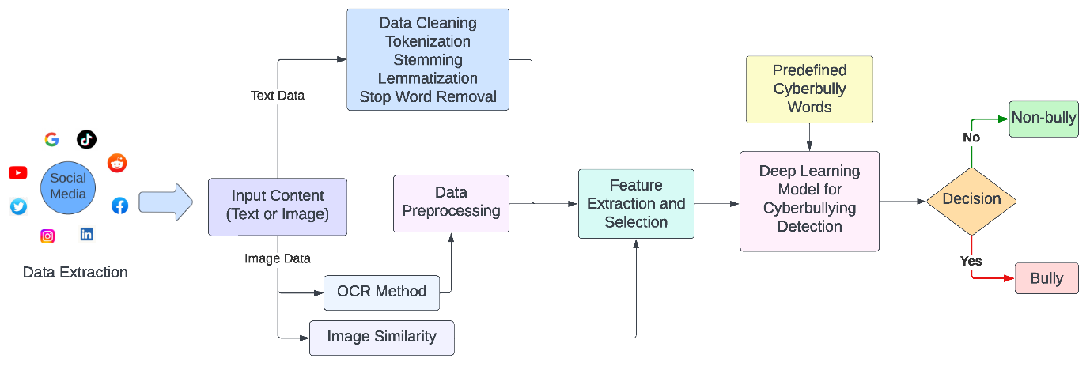
Block Diagram

Slide 14
UML Diagrams
Use Case Diagram
Data Flow Diagram
Sequence Diagram
State Diagram

Slide 15
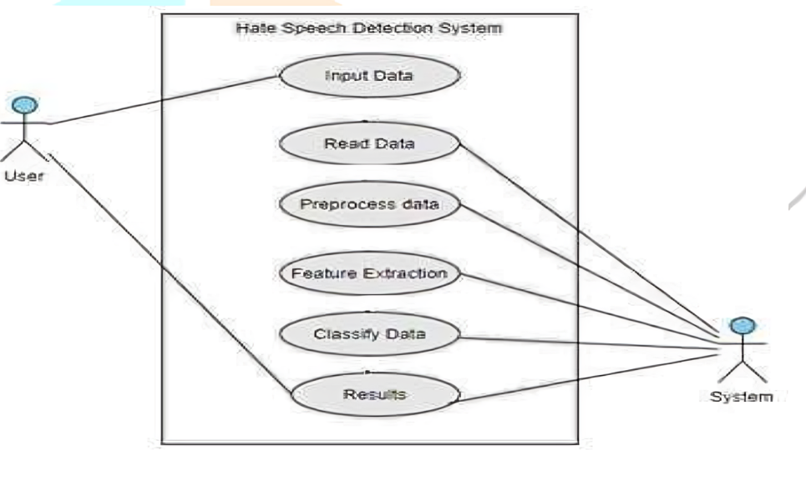
Usecase Diagrams

Slide 16
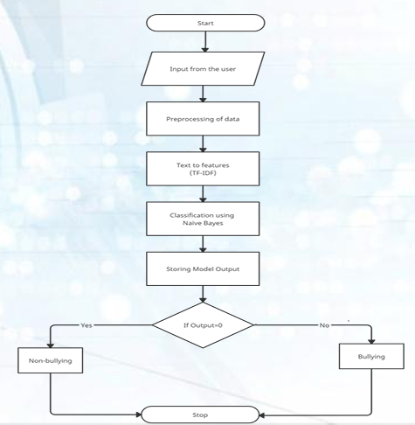
Data Flow Diagrams

Slide 17
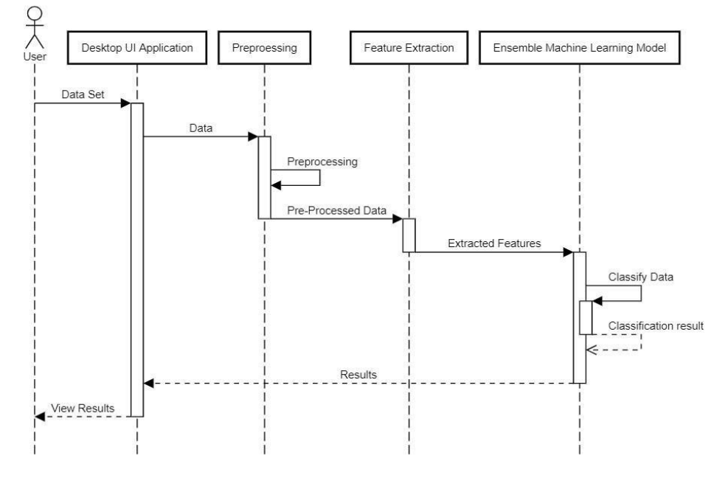
Sequance Diagrams

Slide 18
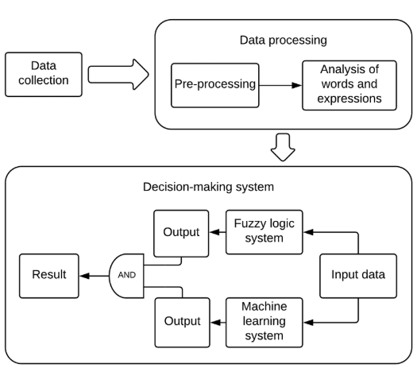
State Diagrams

Slide 19
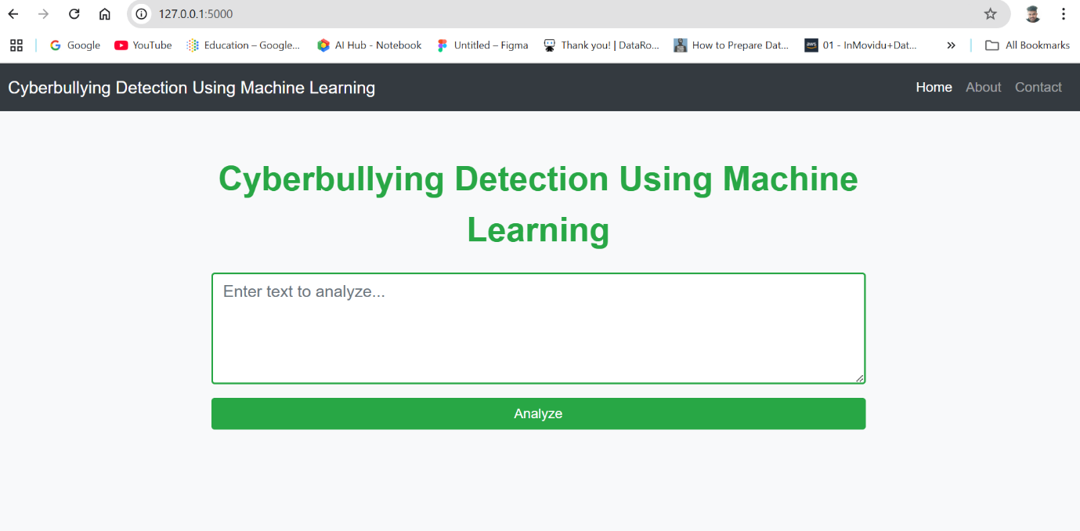
Final Output
Non-Bullying Flow: Whenever the user posts a message in the chat, our prediction service will the load the model and if the text enter is categorized as non-bullying then text or messages will be displayed on the chat screen as shown in the fig below.

Slide 20
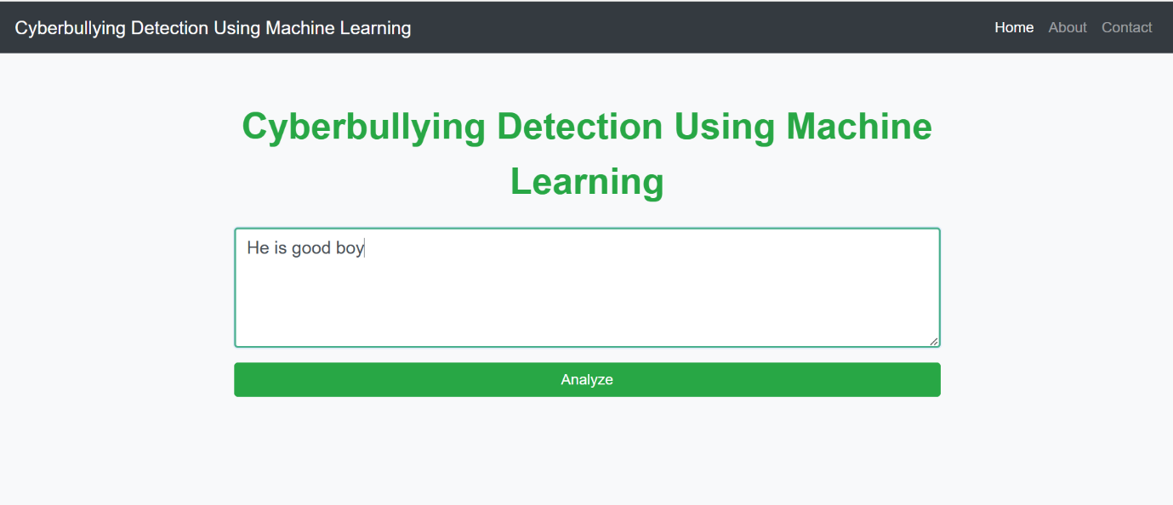
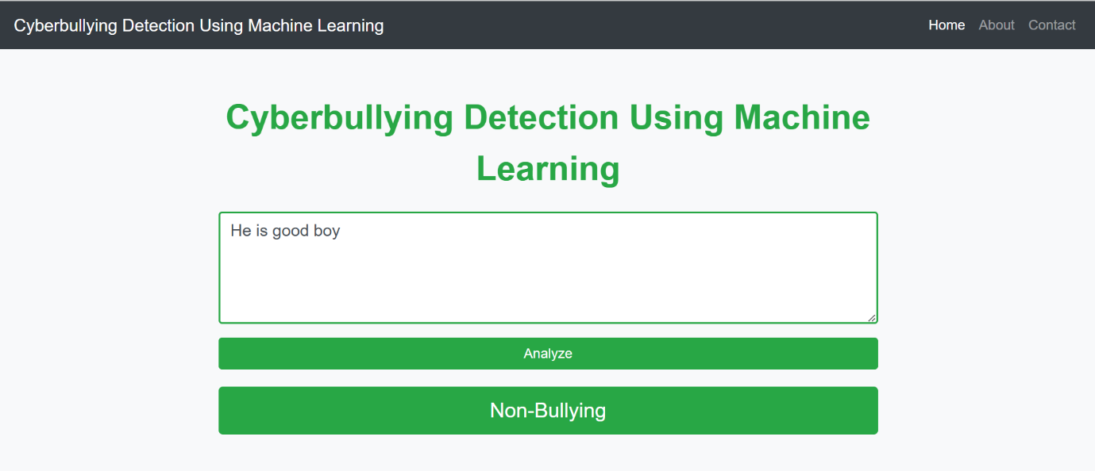
Final Output

Slide 21
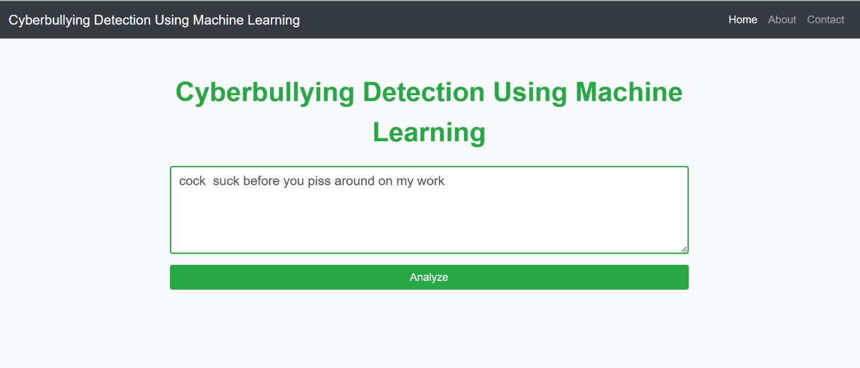
Final Output
Bullying Flow: Whenever the user posts a message in the chat, our prediction service will the load the model and if the text enter is categorized as bullying then text or messages will be displayed on the chat screen as shown in the fig below.

Slide 22
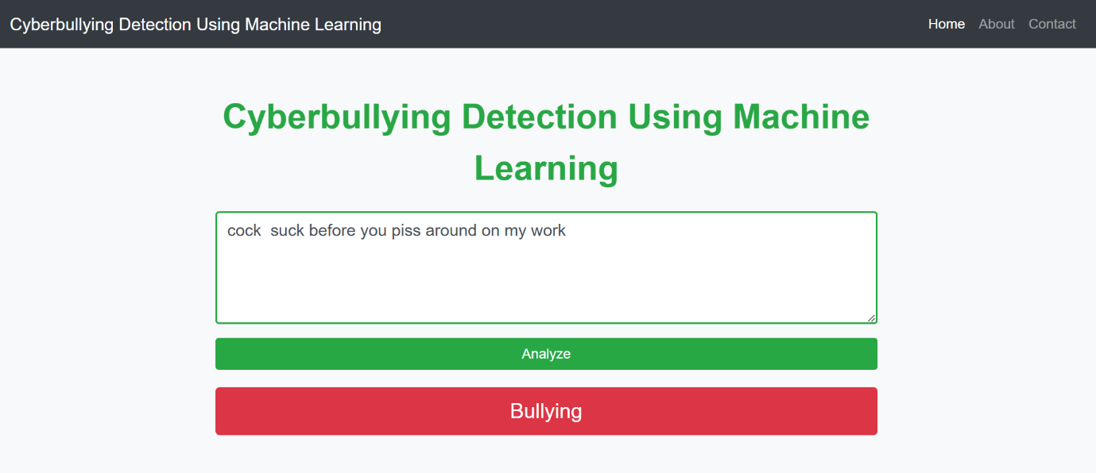
Final Output

Slide 23
Conclusion
This project successfully demonstrates the potential of machine learning to combat cyberbullying by developing a scalable and efficient detection system. Using sklearn algorithms and natural language processing techniques, the system accurately classifies harmful and non-harmful content based on textual data. By addressing challenges like nuanced language, imbalanced datasets, and real-time detection, the project provides a robust framework that can be integrated into social media platforms to enhance user safety.
The solution not only ensures proactive moderation of online interactions but also lays the groundwork for further advancements in automated content analysis. This initiative contributes to creating a safer and more inclusive digital environment, fostering positive interactions across online communities.

